Slide 1
Tools of the Trade: Python
16th Annual AMS Student Conference
22 January 2016 | Seattle, WA
Ryan May (@dopplershift)
UCAR/Unidata

Slide 2
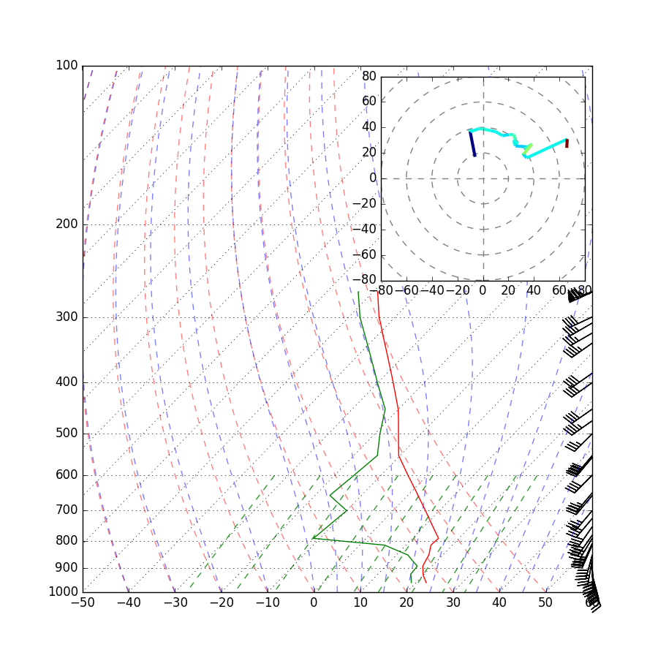
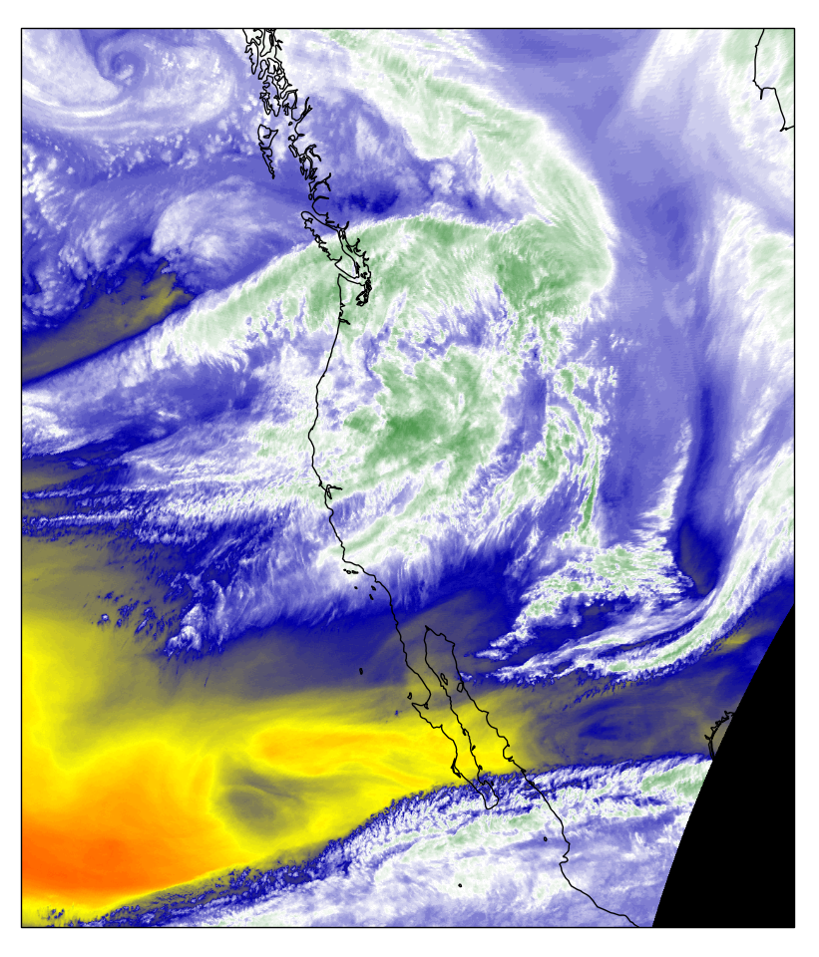
Why Python

Slide 3
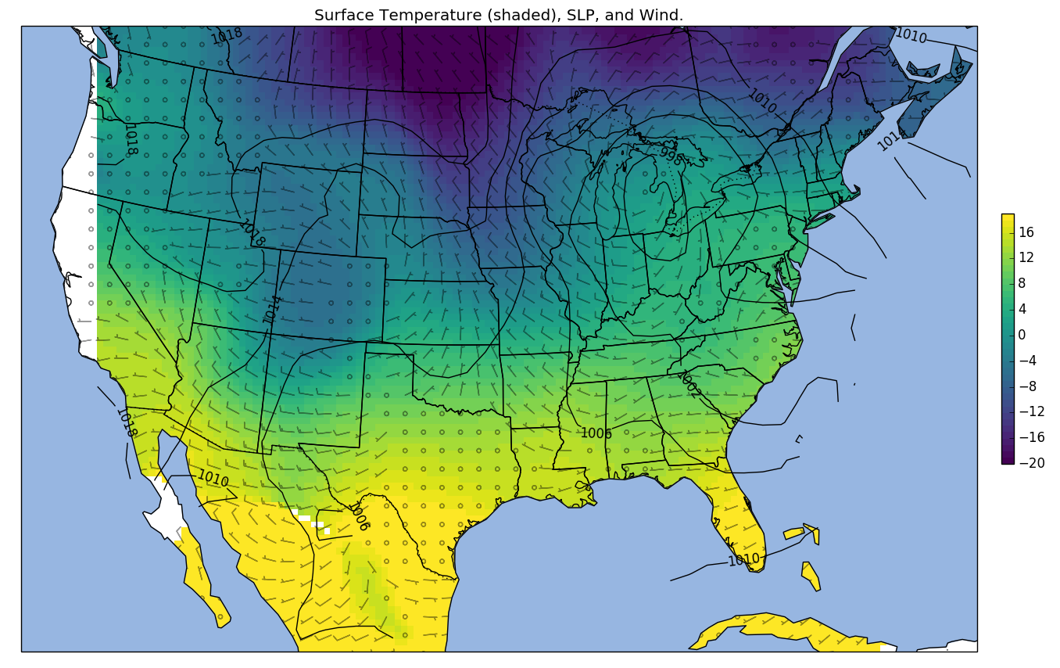

Slide 4
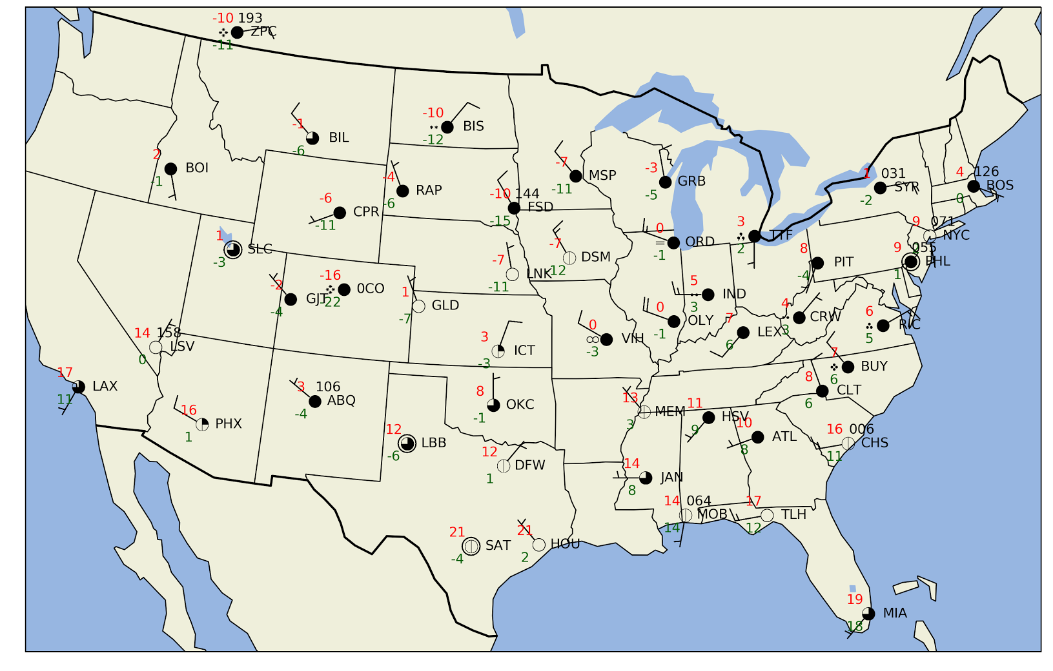

Slide 5
The Double Pendulum System

Slide 6
It’s not just pretty pictures
My projects that have used Python:
Radar simulation
Feeding NEXRAD level 2 data into Amazon S3 archive
Mass data conversion
Scraping information from websites
Prototyping algorithms

Slide 7
Others using Python
Quantitative Finance (e.g. Bloomberg)
Astronomy (e.g. LIGO gravitational wave experiment)
Web Applications (Dropbox)
Many, many others

Slide 8
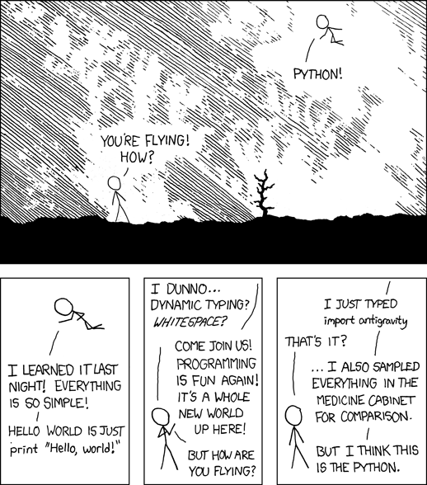
Why Python
General purpose language
Readability
Fits in your brain
Free
Excellent community
https://xkcd.com/353/

Slide 9
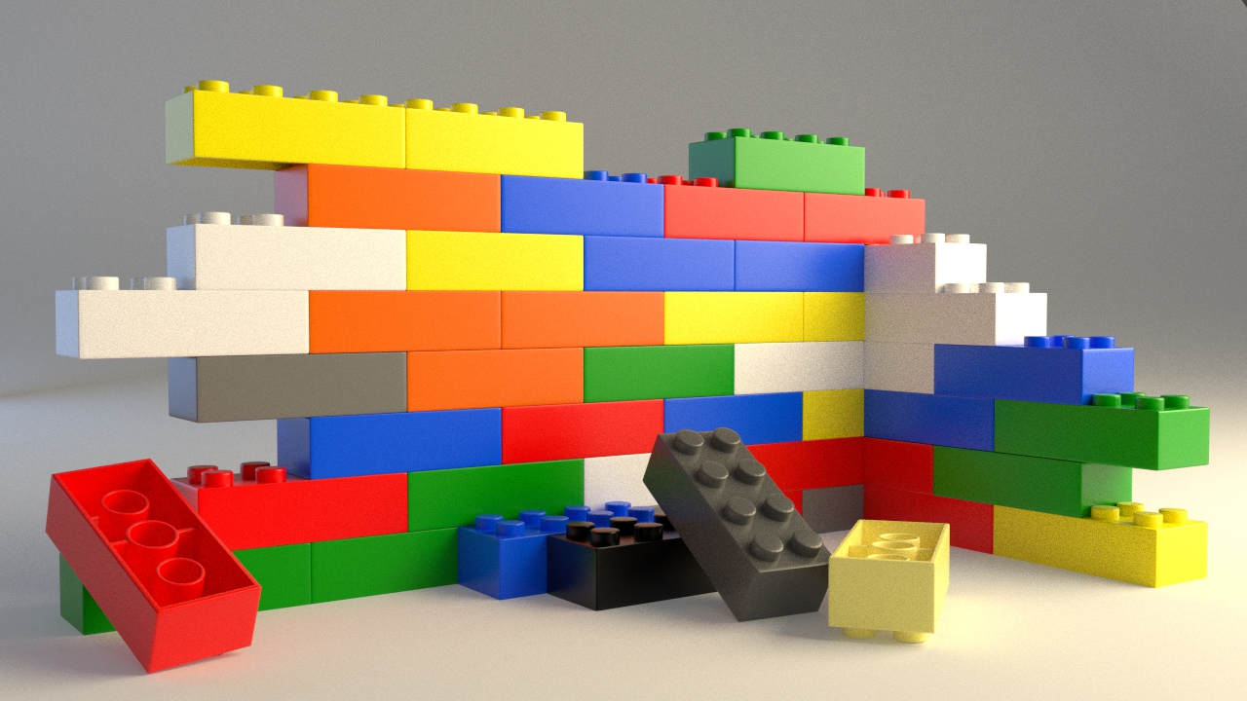
Tools That Fit Together
NumPy: Making arrays great again!
Matplotlib: Publication-quality plots
SciPy: Algorithms w/o writing FORTRAN
IPython/Jupyter: Interactive sandbox
CartoPy: Maps to go with Matplotlib
MetPy: GEMPAK in Python
And many, many more!

Slide 10
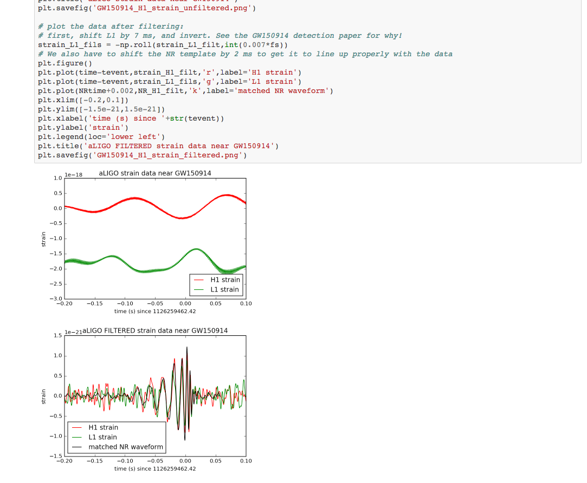
Python for Gravitational Waves?

Slide 11
Community and Support
Community workshops and conferences
Community-developed projects: ANYONE can contribute
Open-source software contributions are a fantastic way to build skills and experience
MetPy: We welcome contributions from students!

Slide 12
Resources
Anaconda Python distribution:
https://www.continuum.io/downloads
Unidata Online Python Training:
http://unidata.github.io/online-python-training
Unidata Python Training Workshop:
http://unidata.github.io/unidata-python-workshop
python-users@unidata.ucar.edu
Can also email me: rmay@ucar.edu
Unidata Summer Internship: Come talk to us at the career fair!

